Slide 1
Pie-in-the-Sky IPL Match Bidding App mini project
GROUP-8-Team members:-
Pranav.S
Syed Ebrahim
Abishek U
Mohammed faraaz.k

Slide 2
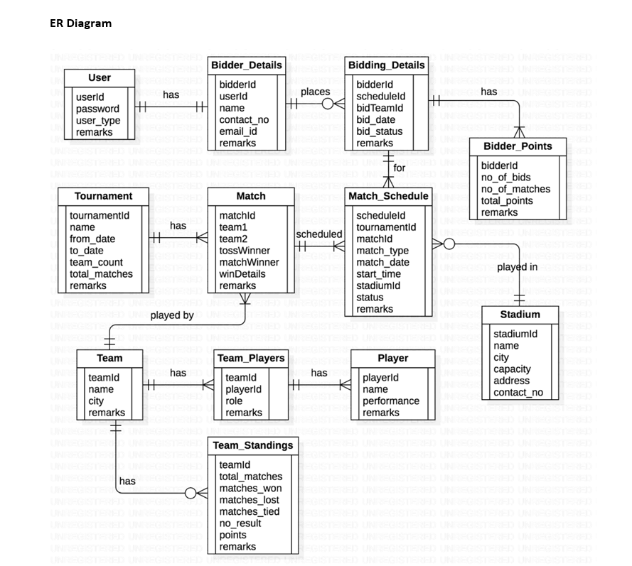
Tables Involved

Slide 3
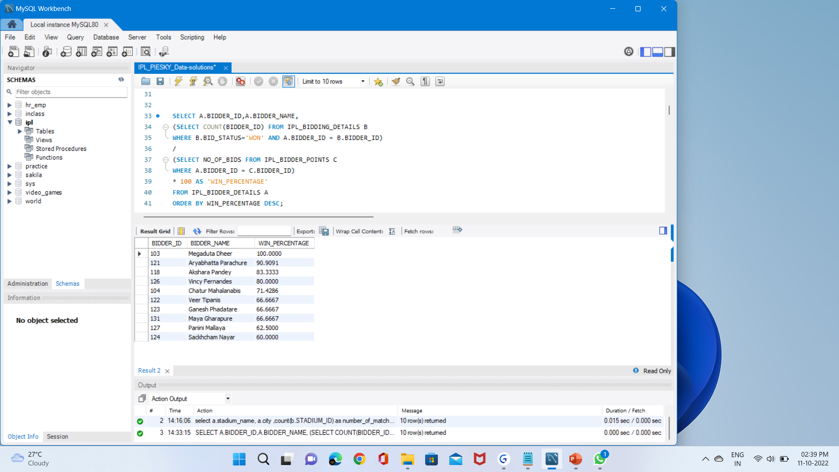
Questions – SQL queries
1.Show the percentage of wins of each bidder in the order of highest to lowest percentage.
Output

Slide 4
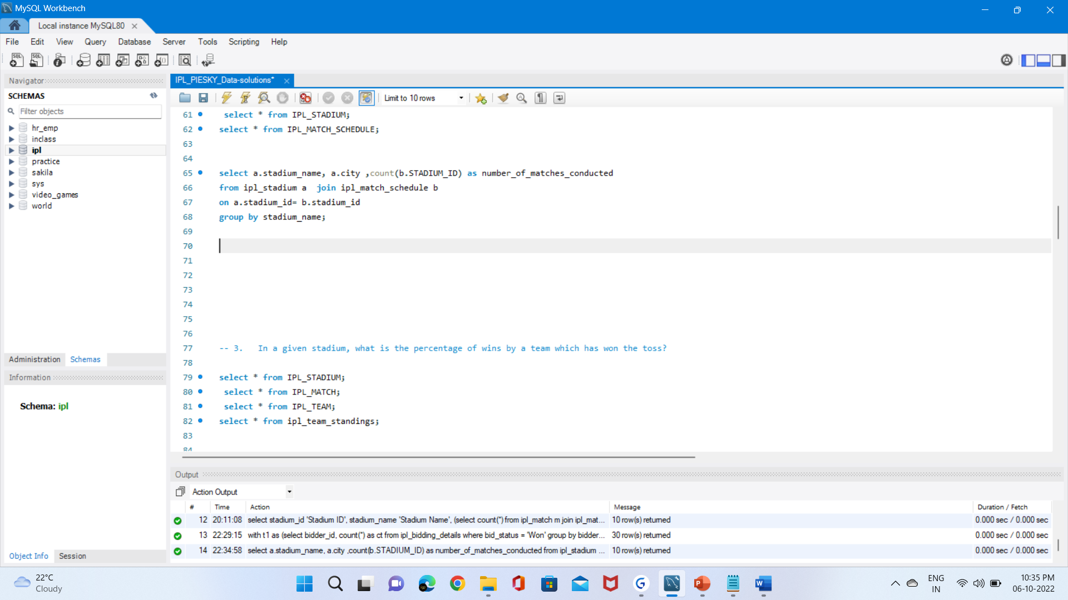
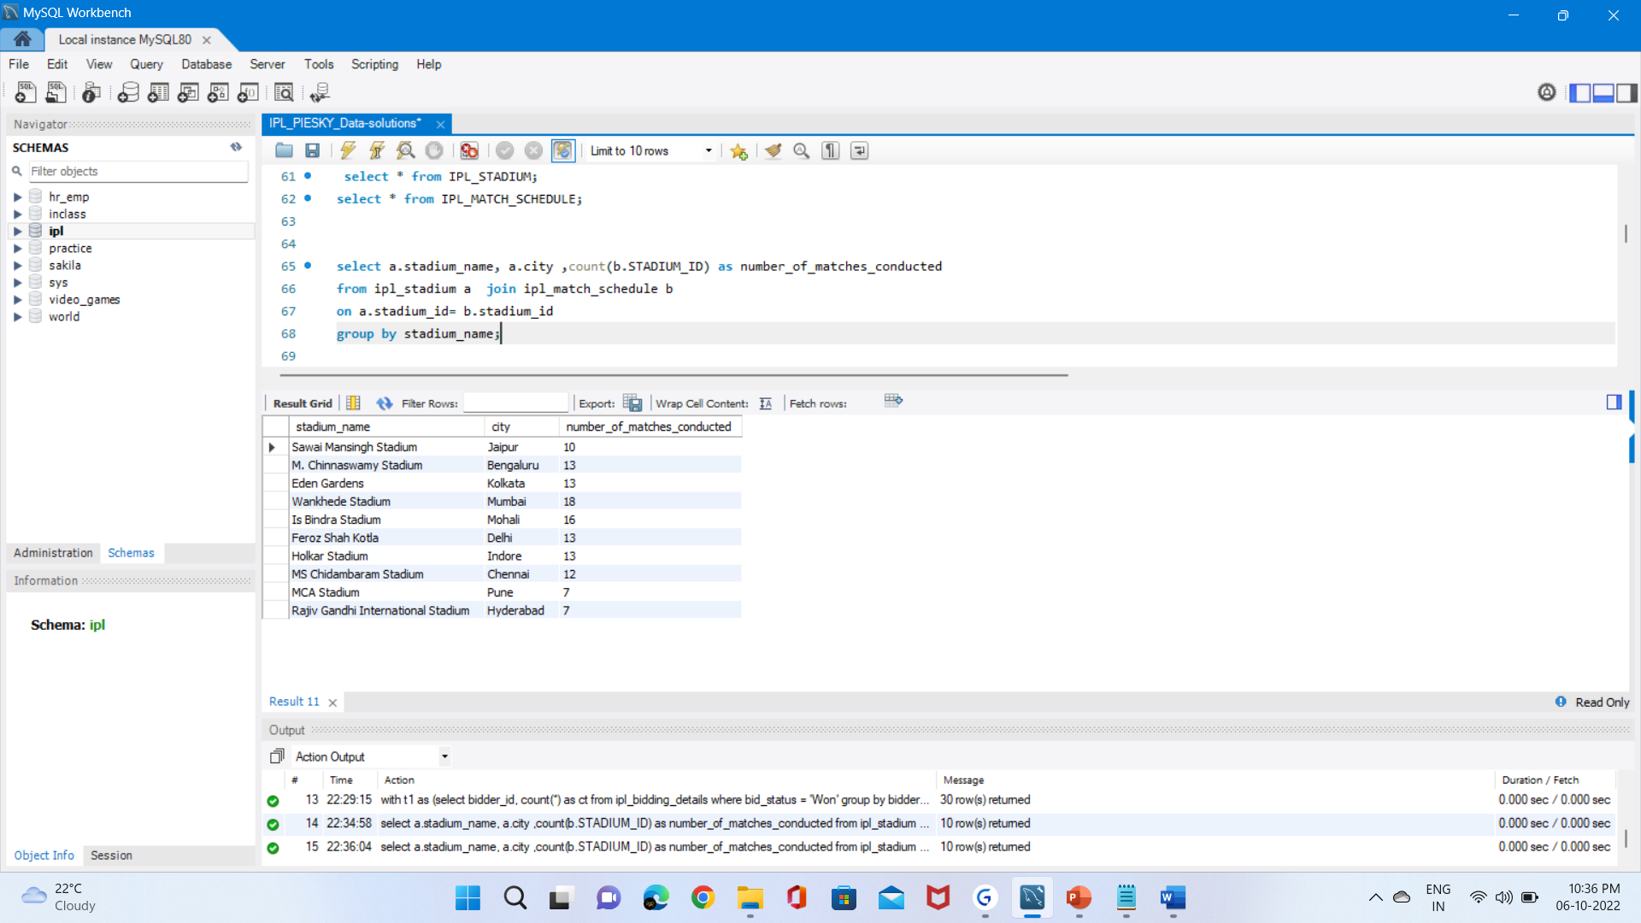
2. Display the number of matches conducted at each stadium with stadium name, city from the database.
Query
Output

Slide 5
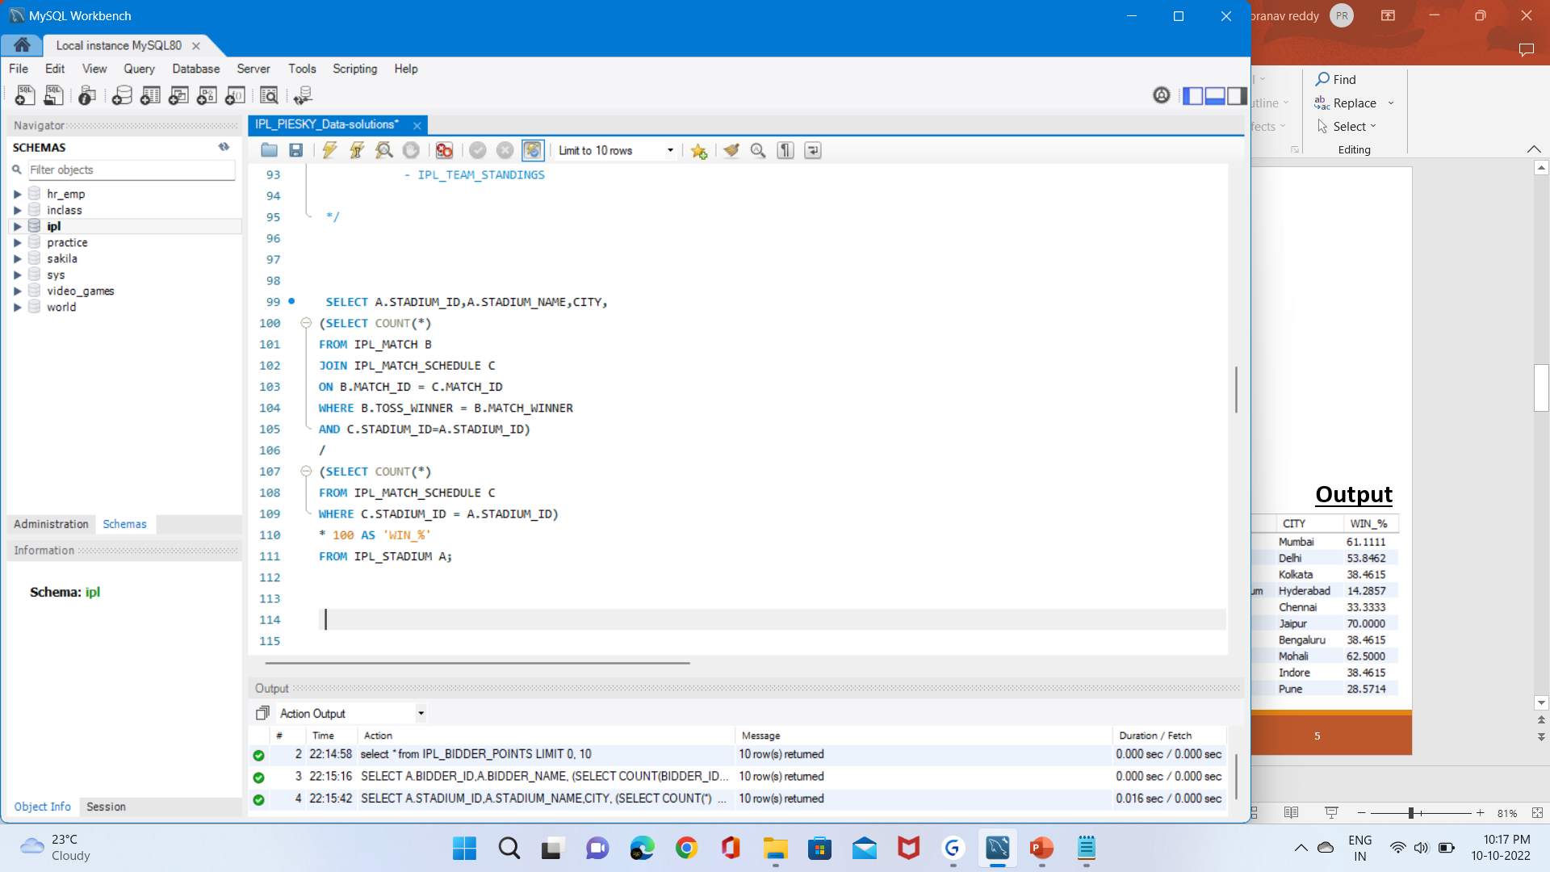
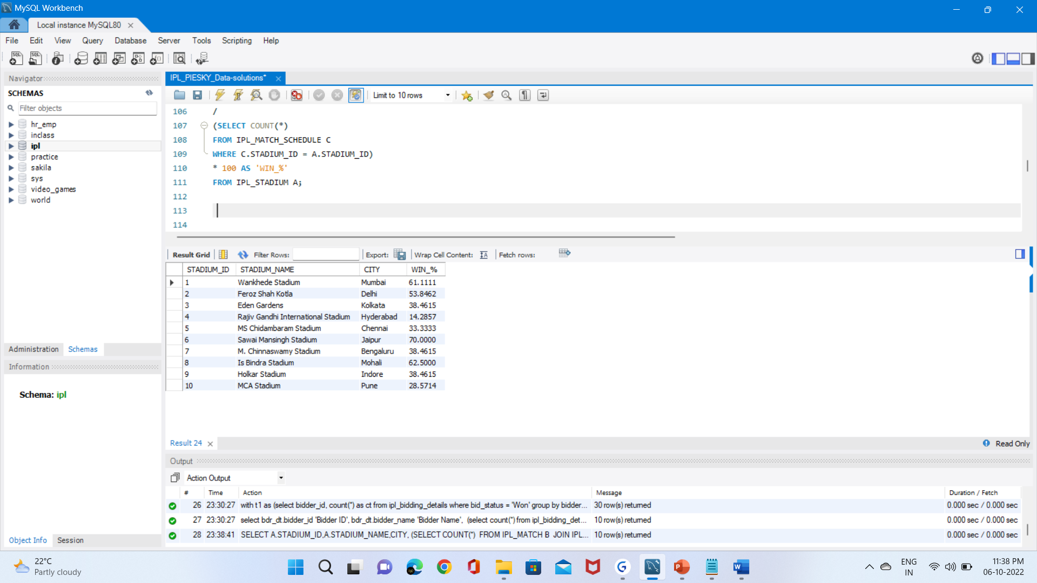
3. In a given stadium, what is the percentage of wins by a team which has won the toss?
Query
Output

Slide 6
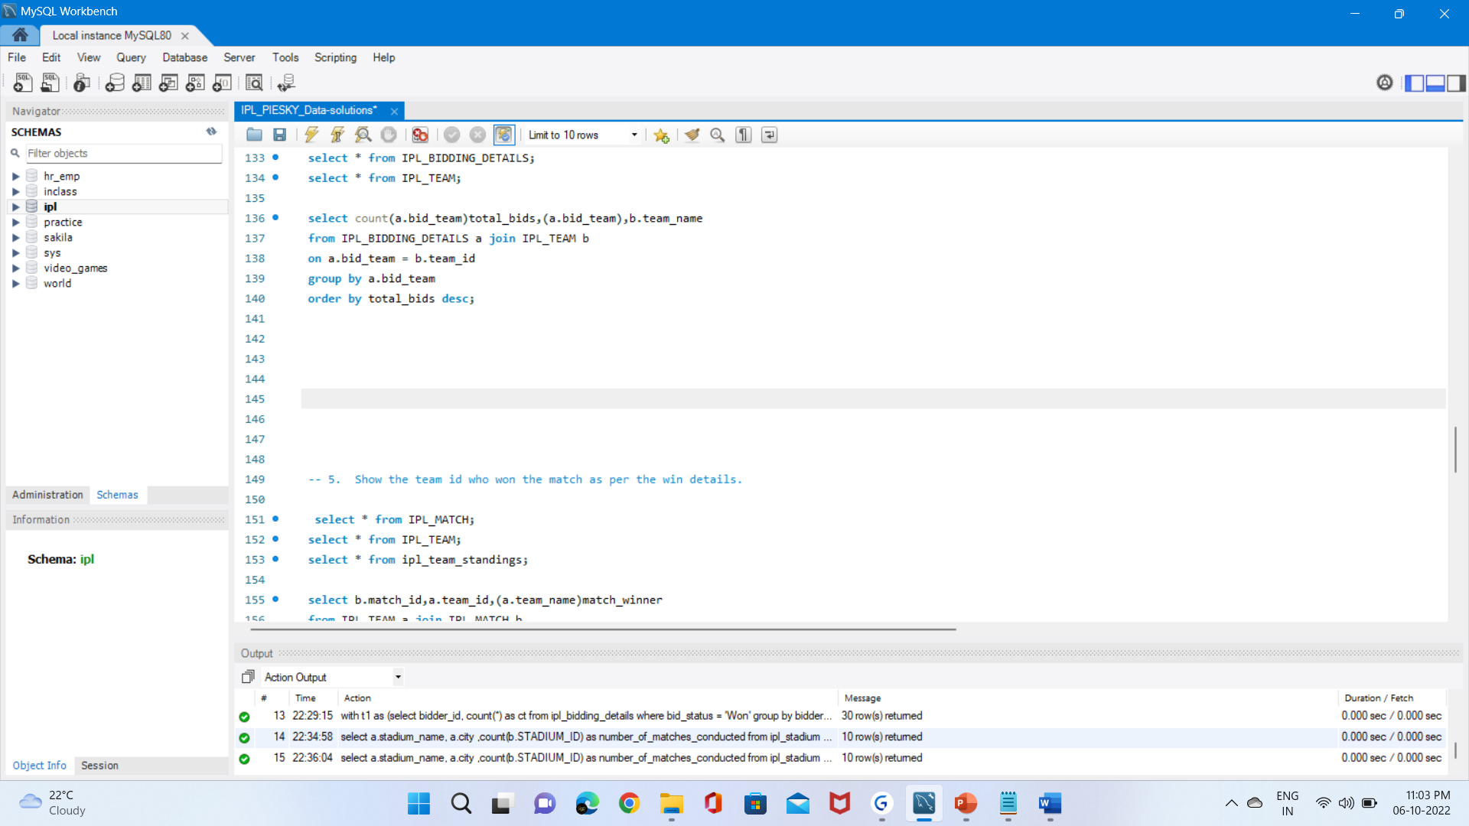
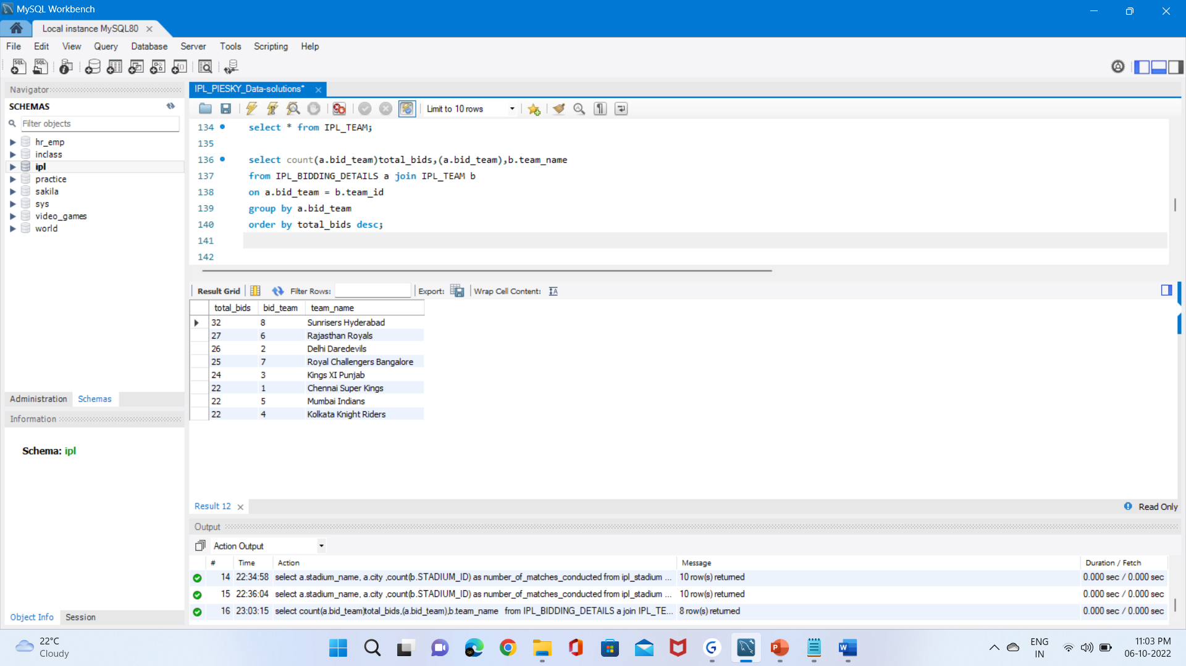
4. Show the total bids along with bid team and team name.
Query
Output

Slide 7
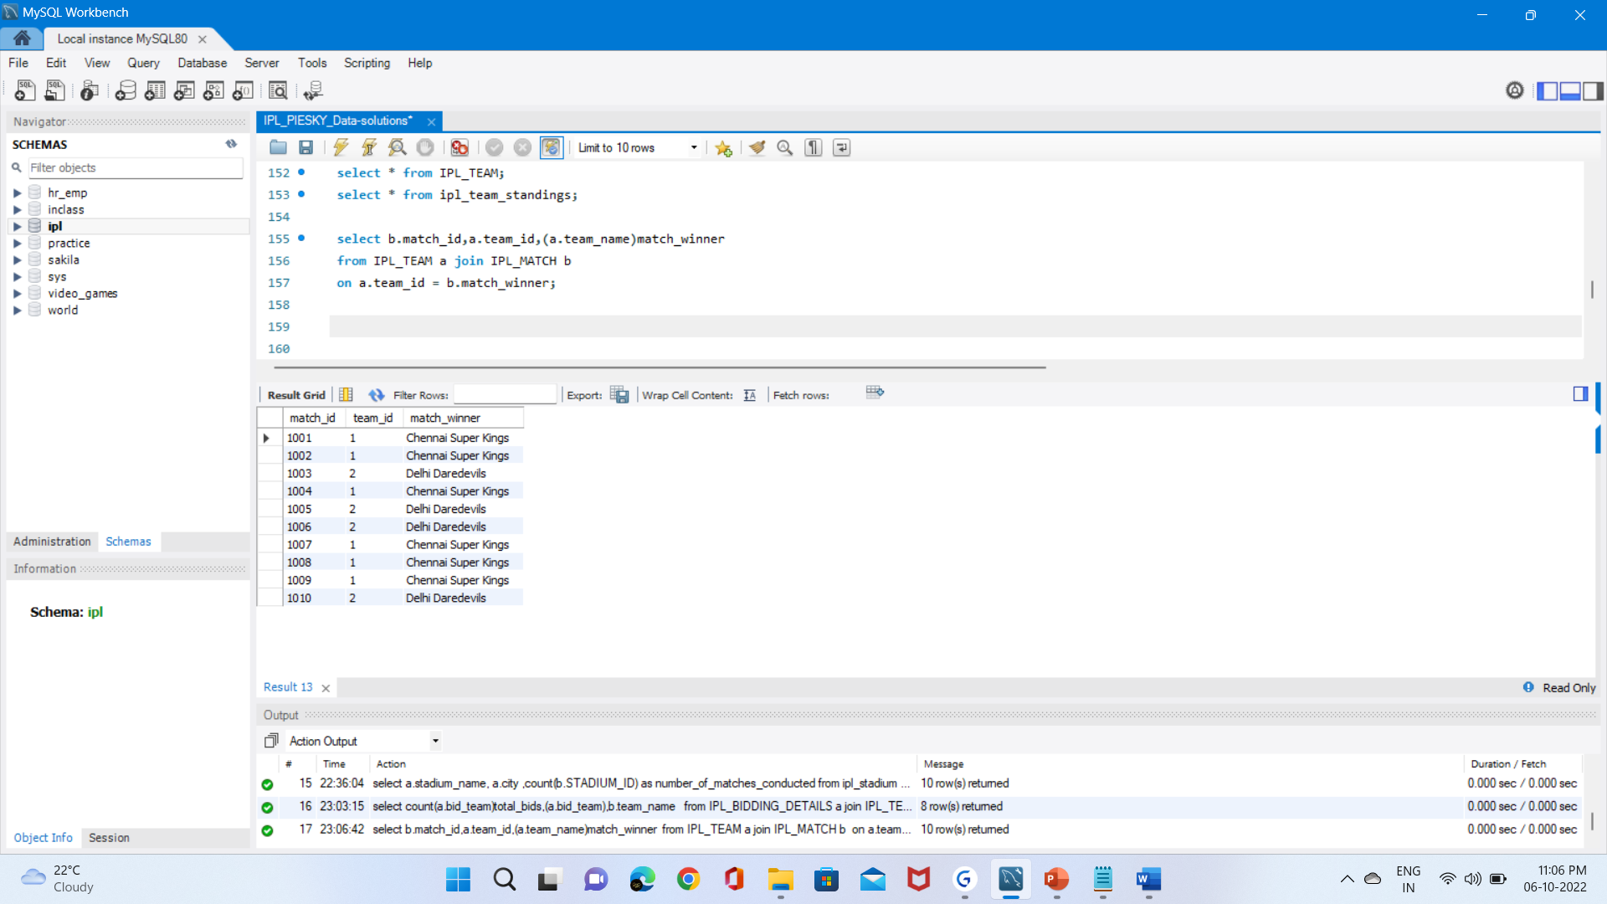
5. Show the team id who won the match as per the win details.
Query
Output

Slide 8
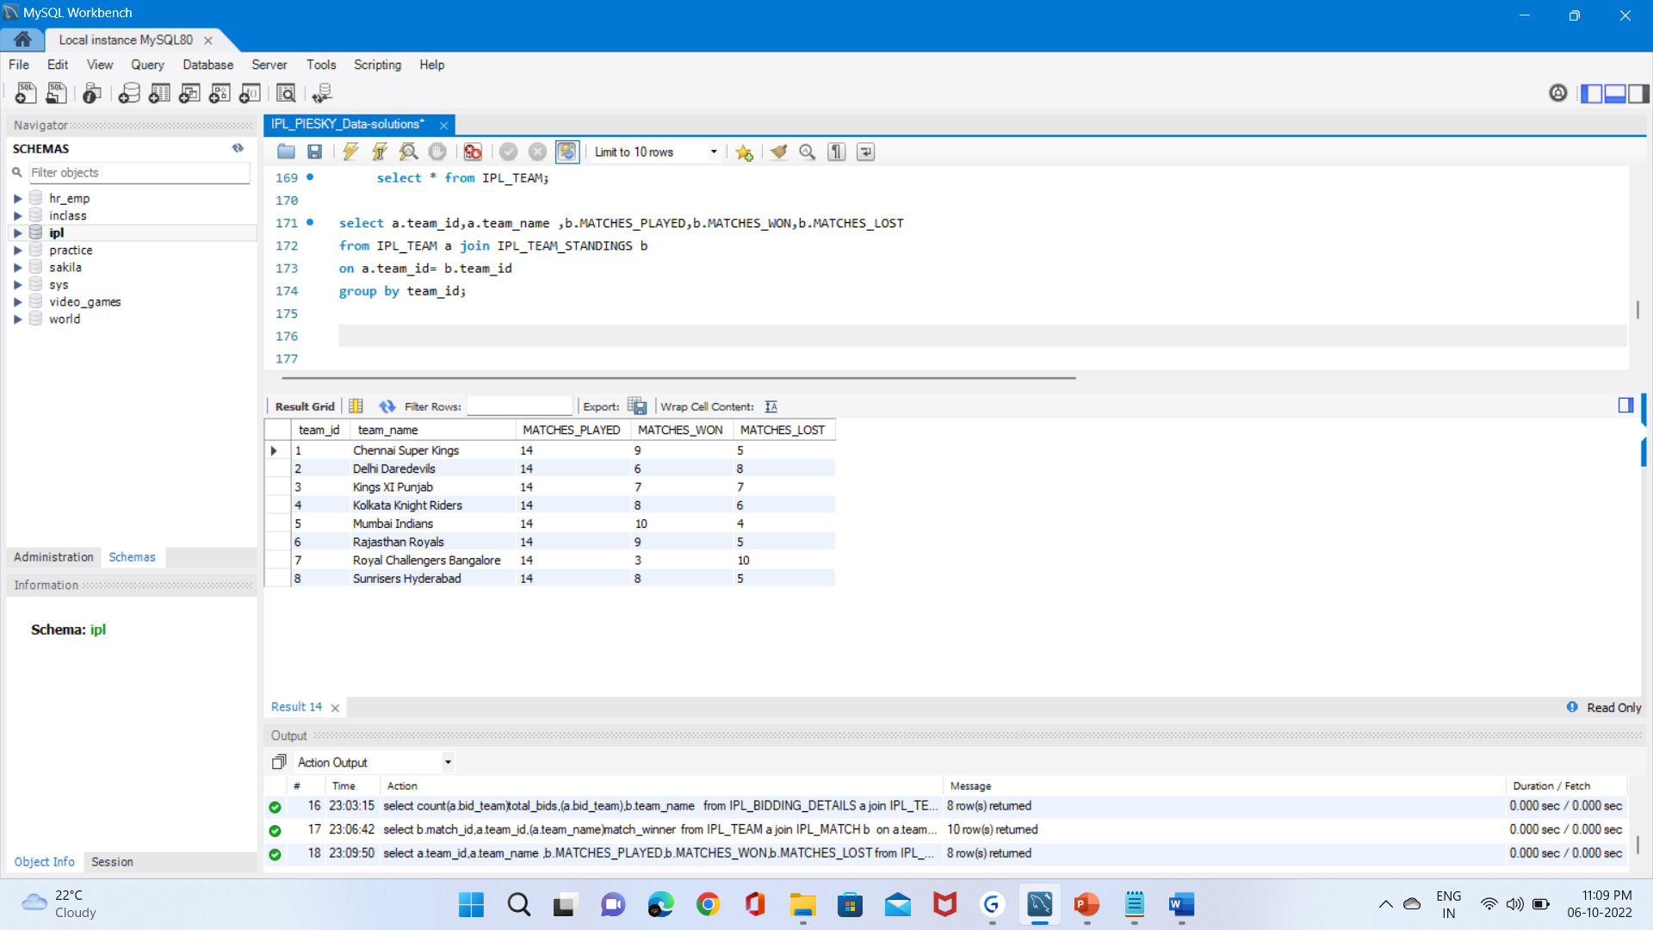
6. Display total matches played, total matches won and total matches lost by team along with its team name.
Query
Output

Slide 9
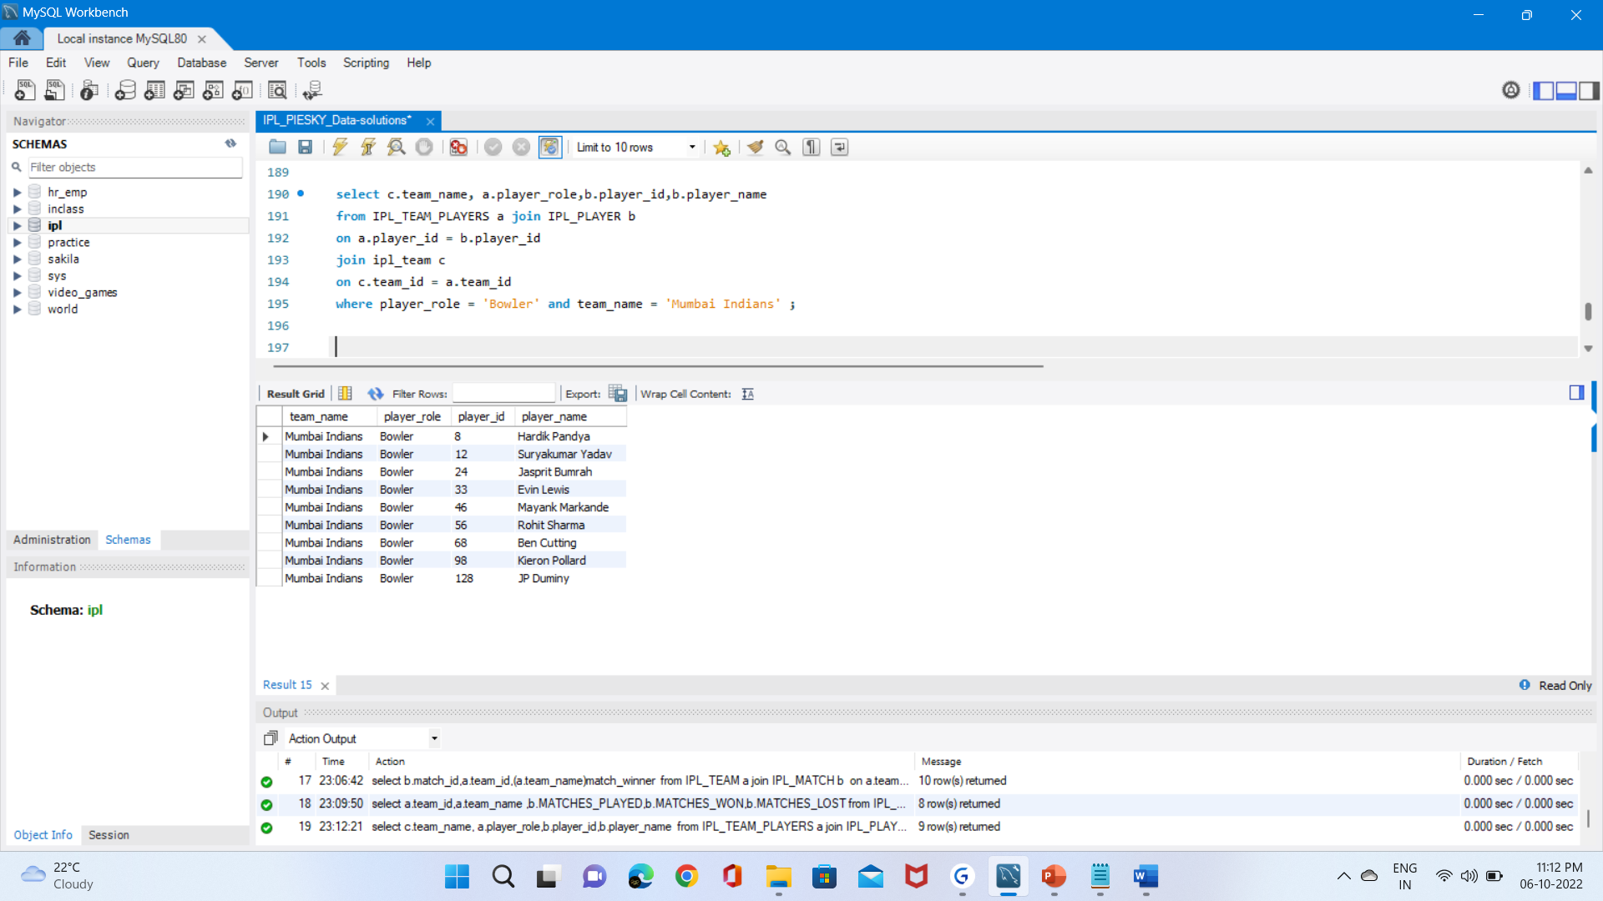
7. Display the bowlers for Mumbai Indians team.
Query
Output

Slide 10
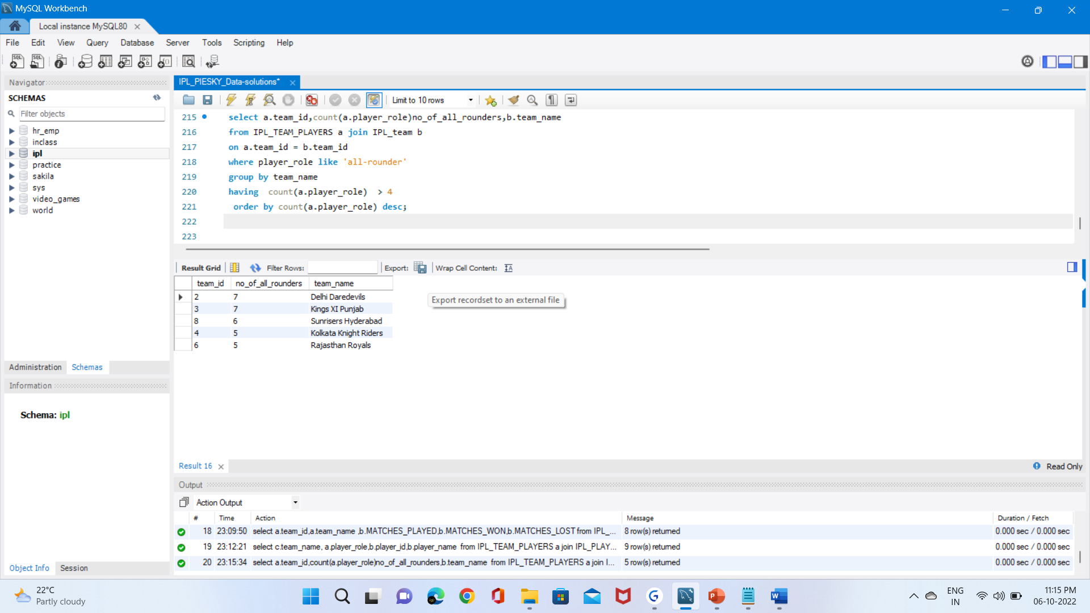
8. How many all-rounders are there in each team , Display the teams with more than 4 all-rounder in descending order.
Query
Output

Slide 11


